Slide 1
Microsoft Intune as part of the Enterprise Mobility Suite
Kathleen Wetherell– Intune SSP
Paul Bourgeau – Intune TSP

Slide 2
Agenda
Introductions – Kathleen Wetherell
The Challenges Mobility Brings to IT and People Centric IT– Kathleen Wetherell
Introduction of the Enterprise Mobility Suite– Kathleen Wetherell
Overview of Microsoft’s Intune with Product Demonstration – Paul Bourgeau
Question and Answers - All

Slide 3
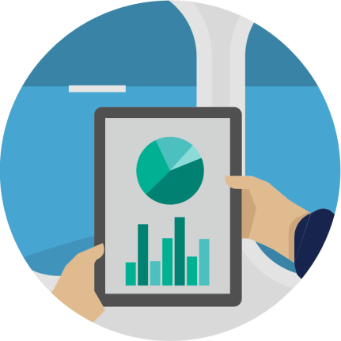
Mobility is the new normal
66%
25%
33%
of employees use personal devices for work purposes.*
of all software will be available on a SaaS delivery by 2020.**
of employees that typically work on employer premises, also frequently work away from their desks.***
*CEB The Future of Corporate ITL: 203-2017. 2013.
**Forrester Application Adoption Trends: The Rise Of SaaS
***CEB IT Impact Report: Five Key Findings on Driving Employee Productivity Q1 2014.
Notes:
There are a couple of mega trends that have been changing the world of work as many of us know it. People no longer just work from their workplace. People work from home, from cafes, from customer sites, on the road, in the air. In fact people can – and do – work from just about anywhere. Even when they’re in the office, people don’t expect to be sitting at their desk in order to be productive.
We are in an era where mobility really is the new normal. The cloud-first, mobile-first world is here. People expect to have the ability to work where, when and how they choose. Using the devices they love and the apps they are familiar with. Just look at the story told by some of these stats: 66% of employees use personal devices for work. A large percentage of employees work away from their desk – even when they are in the office. And BYOD is going to mean a new way of working across apps and data.

Slide 4
What's driving change?
User
Devices
Apps
Data
IT
Notes:
As I mentioned, there are a couple of trends that have taken hold. First is the the influx of consumer devices – some call this the consumerization of IT. Users have choice now in device, platform, sizes. The user can often times determine which devices they’ll work from and they feel a strong affinity for their device. Try to force a user to settle for a device they don’t love or switch to a different one and you’re asking for trouble. Now over 60% of devices flooding the workplace are personally owned – or BYOD.
Then there’s the cloud. People are always connected. And there’s an app for just about everything. This explosion of low-cost SaaS apps means that if a user can’t find a way to do what they want with the tools IT gives them, it’s very easy and cheap to find their own solutions – that’s where Shadow IT is born.
Apps need data – very soon users are finding ways to use not only personal devices but also apps to access corporate data.
Finally, there’s a natural shift as a younger generation enters the workforce. Your new college grads are huge social collaborators already and are bringing those connected, collaboration skills to the workplace and expecting an infrastructure that will support them in how they need to work.
Whatever the drivers, the shift has created a tension between what users need and what IT is responsible for.

Slide 5
Change drives complexity
Microsoft’s unified approach
Risk
Cost
Risk
New Solution
Cost
?
Risk
VDI Solutions
Cost
Data Security Solutions
?
Risk
?
Cost
Risk
ID Solutions
Cost
Microsoft Enterprise Mobility Solution
Complexity
Risk
MDM Solutions
?
Risk
Cost
Complexity
Cost
Complexity
?
System Center
?
Complexity
Complexity
Complexity
Complexity
Laptop
Devices
SaaS Apps
Data
Data and apps anywhere
New Solution
Laptop
Devices
SaaS Apps
Data
Data and apps anywhere
Next big thing
Progress
Notes:
What’s the role of IT in this new world? Is it to keep users productive? Or secure company assets? To embrace change and turn it into a competitive advantage? Or avoid unnecessary risk? The answer is, of course, all of the above. The buck really does start and stop with IT. But keeping up with such fast moving and changing trends has its own challenges. IT has had to jump-in and fire-fight on several fronts: from getting unmanaged devices on the corporate network under policy to coming up with strategies to avoid sensitive customer data from falling into the wrong hands. All while keeping users happy…
Let’s take a look at what that means for your average user and your average IT administrator. Start with the user. They’re always on the road and works from a number of different devices and locations. They need email on their devices – whether that’s a PC, tablet or phone. They also want apps. LOB apps. Productivity apps. And more recently SaaS apps. The user expects to have access to all the apps they need to stay as productive as possible wherever they are. But they also need to be able to work on documents across devices, so they need a way to pull synchronized data from the cloud to be accessed on different devices. And that may mean that they require access to sensitive data while they’re out on the road using a non-corporate device.
For the IT admin, all these scenarios create risk. A certain amount of risk can be tolerated. But as user requirements increase, IT has to take action to ensure the risk is maintained at an acceptable level
Having one user identity for accessing corporate on-premises applications and a different identity or identities for cloud apps is creating extra work for IT and putting a burden on the user to remember a lot of different logins and passwords.

Slide 6
Empowering enterprise mobility
Enable your users
People-centric approach
Protect your data
User
Devices
Apps
Data
IT
Unify your environment
Notes:
Microsoft takes a people-centric approach to enterprise mobility – meaning we focus on productivity and efficiency for everyone – IT and users. We look across user devices, data and application – but always centered on the needs of the users.
We has a history of providing rich IT-infrastructure solutions to help manage every aspect of enterprise operations. Microsoft’s people-centric solution consists of products and technologies that can help IT departments handle the influx of consumer-oriented technology and the work style expectations of users, thereby helping increase productivity and satisfaction for the people within their organizations.
With our Enterprise Mobility Suite, we’re helping organizations address the three constant business challenges:
First, Enabling users to be as productive as possible by allowing users to work on the device(s) of their choice and providing consistent access to corporate resources from those devices.
Second, Helping IT to protect your data by protecting corporate information and managing risk. And lastly
Unifying your environment by delivering easy to use application and device management from both your existing on-premises infrastructure, as well as cloud-based services, including Windows Intune and Windows Azure.

Slide 7
What is the Enterprise Mobility Suite?
Hybrid identity
Microsoft Azure Active Directory Premium
security reports, and audit reports, multi-factor authentication
Self-service password reset and group management
Connection between Active Directory and Azure Active Directory
Access & Information protection
Microsoft Azure Rights Management service
Information protection
Connection to on-premises assets
Bring your own key
Mobile device management
Windows Intune
Mobile device settings management
Mobile application management
Selective wipe
Want more information on Hybrid Identity or Access & Information Protection? Contact your Account Executive
Notes:
For today’s session we are going to focus on the Mobile Device and Application Management solution we call Microsoft’s Intune but as you can see from the first two components in this slide Hybrid Identity and Access and Information Protection are very important in this vision of People Centric IT.
If after this session you’d like to learn more about the other components of EMS, reach out to Yanni and he can arrange for us to dive deeper on Hybrid Identity or Information protection.,

Slide 8
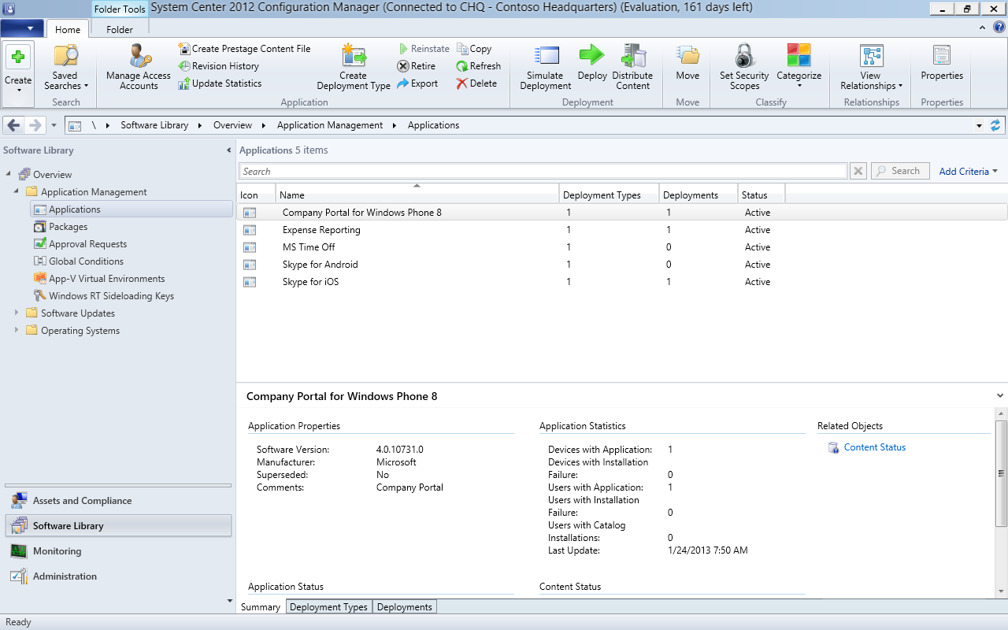
Mobile Device Management Overview
End-User Self-Service
Mobile Device Inventory
VPN Profile Management
Application Management
Wi-Fi and Certificates
Settings Management
Device Retirement/Selective Wipe
Rich Company Portal Experience
Notes:
Getting devices under management is the first step in undergoing any MDM or Mobile Device Management project, but giving the user the ability to self service is also important.
Should a device be lost or stolen, having the ability to remove the corporate data becomes KEY in mitigating risk of sensitive student data getting into the wrong hands. With Intune, we have the ability to push wi-fi and vpn profiles to the device as well an manage certificates.
We provide a rich company portal experience for users to gain access to the applications they need to do their jobs, contact IT or report a device lost or left in a taxi, etc.
With Intune, you can easily remove a device from management should a user leave your organization – the ability to remove just the corporate data is important as well. On a user owned device, they aren’t going to want you removing their photos or music. Being able to remove just that corporate data from a user owned device, virtually absolves you of any litigation if you’d wiped a device back to factory standards.

Slide 9
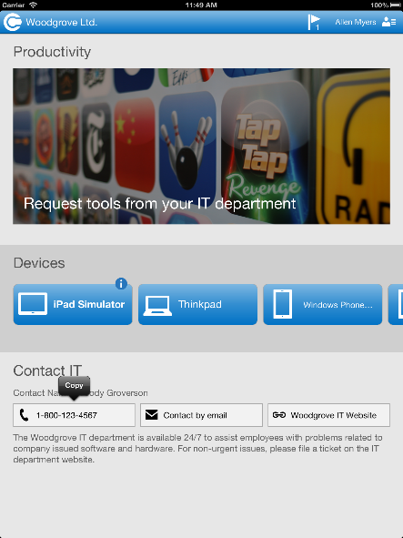
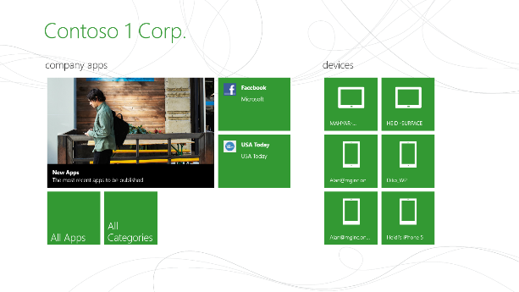
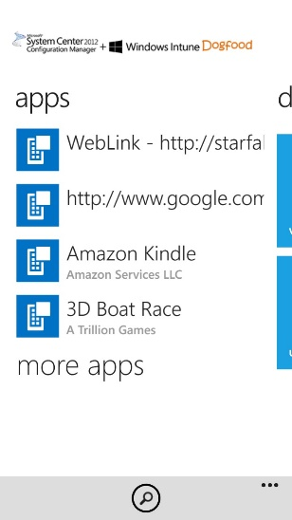
End User Experience
Consistent Company Portal experiences across mobile platforms
Windows RT
Company Portal
Windows Phone 8
Company Portal
iOS/Android
Company Portal
Native Windows app package (.appx)
Available in the Windows Store
Native Windows Phone 8 app (.xap)
Available in the Windows Store
Native iOS app
Available in the Apple Appstore™
Notes:
Here are a few examples of what our company portals look like, as you can see on a Windows device, the portal resemble a Windows App, and vice versa with an Android or IOS device – I’ll have Paul show you this live in a moment. So you can see the experience from both the IT and user perspectives.

Slide 10
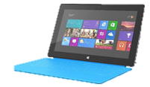
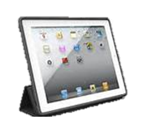
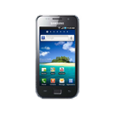
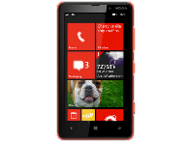
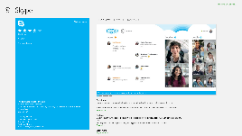
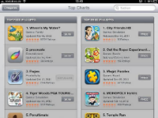
Application Management on Mobile Devices
Platforms | Windows 8/Windows RT | Windows Phone 8 | iOS | Android
Line-of business apps (sideloaded) | *.appx | *.xap | *.ipa | *.apk
Deep links to store apps – install from store
Web-shortcuts installed on device desktop | Yes | Yes | Yes | Yes
Notes:
As I mentioned earlier, with Intune you have the ability to side load line of business apps to the device and also create deep links to app store apps. Allowing the user to access any and all apps associated with their job duties.

Slide 11
For More Information
System Center 2012 Configuration Manager
http://technet.microsoft.com/enus/evalcenter/hh667640.aspx?wt.mc_id=TEC_105_1_33
Windows Intune
http://www.microsoft.com/en-us/windows/windowsintune/try-and-buy
Windows Server 2012 RDS/VDI:
http://technet.microsoft.com/en-us/windowsserver/ee236407.aspx
http://www.microsoft.com/en-us/windows/enterprise/products-and-technologies/virtualization/vdi.aspx
More Resources:
microsoft.com/workstyle microsoft.com/server-cloud/user-device-management
Notes:
With the release of Windows 8, Windows Server 2012, Configuration Manager 2012 SP1, and the latest Windows Intune release, we have a comprehensive solution to help you manage your users and devices. We encourage you to evaluate and deploy all of these technologies. You can find more resources on microsoft.com.

Slide 12
© 2012 Microsoft Corporation. All rights reserved. Microsoft, Windows, Windows Vista and other product names are or may be registered trademarks and/or trademarks in the U.S. and/or other countries.
The information herein is for informational purposes only and represents the current view of Microsoft Corporation as of the date of this presentation. Because Microsoft must respond to changing market conditions, it should not be interpreted to be a commitment on the part of Microsoft, and Microsoft cannot guarantee the accuracy of any information provided after the date of this presentation. MICROSOFT MAKES NO WARRANTIES, EXPRESS, IMPLIED OR STATUTORY, AS TO THE INFORMATION IN THIS PRESENTATION.

