Slide 1
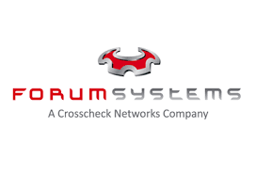
API Security Management
Cyber Protection for Modern Enterprise Architecture

Slide 2
eVigilant Overview
General
Privately Owned – Established in 1999
Headquartered in Lorton, VA
Class “A” Contractor with $4 million liability insurance
Major Services
Focused on integrated security solutions:
Cyber Security and Information Assurance
Electronic Security and Asset Protection
Communications, Network, and General Engineering
Command and Control
Intelligence Support Services
Contracting Vehicles
MEEC Cyber Security – C2015-09-P GSA GWACS – STARS2 – GS06F0817Z Schedule 70 - GS35F178AA Schedule 84 - GS07F0178W DoD - Navy Seaport-e

Slide 3
Forum Systems
General
Independent, employee-owned and profitable engineering firm – Established in 2001
Headquartered in Boston, MA
Class “A” Contractor with $4 million liability insurance
Major Services
Focused on API Security:
Provider of Forum Sentry API Security Gateway.
Combines cybersecurity, identity, data privacy and data conversion.
Modern and Secure Architecture Design: Forum Sentry is built upon a secure architecture with FIPS 140-2, NDPP, and DoD PKI industry certifications
Proven, Secure and Trusted
Critical path technology provider to Governments and Enterprises globally for 14+ years
Purpose-built, vendor agnostic product technology with no code declarative policies.

Slide 4
Discussion Points
Cyber Attack Vulnerabilities
Traditional vs Modern Architecture
The Emergence of APIs
Anatomy of API Security
API Security Gateway for Modern Architecture Design

Slide 5



Cyber Attacks – The New Era
“In the latest in a string of intrusions into U.S. agencies' high-tech systems, the Office of Personnel Management (OPM) suffered what appeared to be one of the largest breaches of information ever on government workers.”
– June 24 2015
“T-Mobile customers' info breached after Experian hack” – Oct. 1, 2015
“NSA warns of growing danger of cyber-attack by nation states”– Oct. 27, 2015

Slide 6
Modernization & APIs – New Enterprise Architecture
Traditional Architecture
API-Based Architecture
Silo applications
Selective integrations and network controlled data flows
Custom external integration is case-by-case and not repeatable
Adopted for business integration
Modular for agility
Standards-based externalized integrations
Mobile and cloud capable
Your
Enterprise
Business APIs
Legacy Enterprise
Modern Enterprise

Slide 7
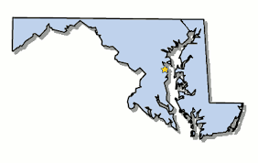

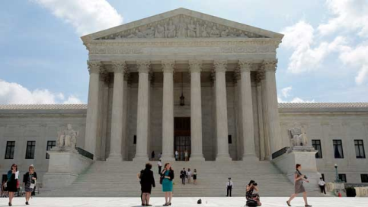

New Enterprise Architecture = New Security Challenges

Slide 8
New Enterprise Architecture = New Security Challenges
Mobile
Public
Cloud
Suppliers
Innovators
Unknown parties
Smart Devices
Employees
Partners
Monetary Services
Business APIs
Application APIs
Data APIs
Modern Enterprise

Slide 9
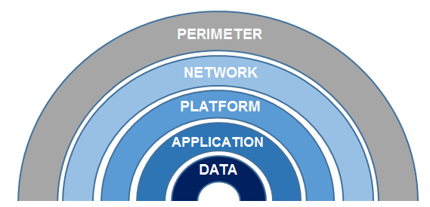
Traditional CyberSecurity Focal Points
Denial of Service
Event Monitoring
Antivirus Signatures
Network Behavior Anomalies
Protocol Firewall, IDS, DDOS
VPN, DMZ, Network Access control, SEIM
AV, Configuration Management
Whitebox, Malware
File Encryption, Local AV

Slide 10

API Security Focal Points
Relationship between Identity and Data
Role-Based Access Control
Content-Based Access Control
Embedded Data Privacy/Trust
Type of Client (Mobile, Cloud, B2B)
Course-Grained
Transport (SSL/TLS, HTTP, JMS)
Transaction content (SOAP, REST, JSON)
Fine-Grained
Format Validation (Schema, Attributes)

Slide 11
API Security Concept
in Practice:
Airport Security

Slide 12

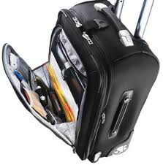
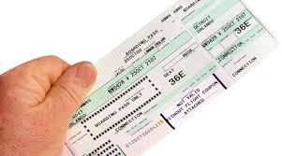
“API” Attributes
Authentication: Valid user
Conditions: On watch list
Transaction details: Source / Destination
Role:1st Class, Coach, Known Traveler
liquids, gels, knives, guns
size and weight
Content analysis:
Payload analysis:

Slide 13


Airport Security
Checkpoint 1
Checkpoint 2
Checkpoint 3
Checkpoint 4
Check ID
Check Ticket
Check Bag
Assess User Profile

Slide 14
Airport Security
Checkpoint 1
Checkpoint 2
Checkpoint 3
Checkpoint 4
Check ID
Check Ticket
Check Bag
Assess User Profile

Slide 15
Airport Security
Checkpoint 1
Checkpoint 2
Checkpoint 3
Checkpoint 4
Check ID
Check Ticket
Check Bag
Assess User Profile

Slide 16
Airport Security
Checkpoint 1
Checkpoint 2
Checkpoint 3
Checkpoint 4
Check ID
Check Ticket
Check Bag
Assess User Profile

Slide 17
Airport Security
Checkpoint 1
Checkpoint 2
Checkpoint 3
Checkpoint 4
Check ID
Check Ticket
Check Bag
Assess User Profile

Slide 18



The Emergence of the API Architecture
API is the access point (interface) to the service or data
  The Service
  Mobile, B2B, Portal, Data …
  (HTML, XML, SOAP, REST, JSON, …)

Slide 19
API Ecosystems
Cloud | Web Applications
Exposed and consumed via standards-based technology for rapid integration and adoption
Big Data| Analysis
Big data analytic engines expose and monetize results via APIs
Externalization
Modernization
APIs
The Integration Point of Innovation
Mobile| Apps
Use web services for calls to back-end servers delivering data and logic
Portals| Users
Personalized experience, seamless and unified access to information resources

Slide 20
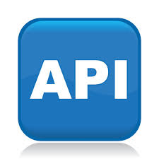


The Agility of API Abstraction
Web Site
Mobile Device
Web Portal
B2B Partner
Cloud App
Sat Link
Company Assets and Services

Slide 21
Anatomy of Modern API Security
  The Service
  Mobile, B2B, Portal, Data …
  (HTML, XML, SOAP, REST, JSON, …)

Slide 22

Anatomy of Modern API Security

Slide 23
Anatomy of Modern API Security
  Transport Security
  SSL/TLS
  IP, Port, URL
  Transport Security
  SSL/TLS
  IP, Port, URL
Threat Mitigation
Content-Aware (SOAP, REST, …)
Intrusion Detection and Prevention
  Data Leakage
  Embedded Malware
  Role-Based Access Control
  AuthN, AuthZ
    Data Privacy
      Content Encryption
      Content Decryption
    Integrity and Trust
      Digital Signature
      Signature Verification
      Schema Validation
  Attribute Based Access Control
  Subject, Object, Environment

Slide 24
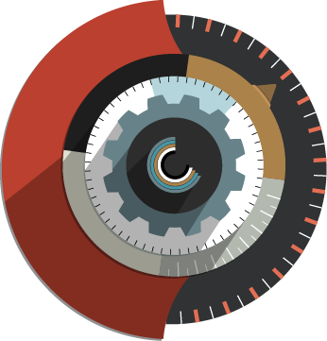
API Security Management – Decouple from Service

Slide 25
API Security Management – Decouple from Service
  The Service
  Mobile, B2B, Portal, Data …
  (HTML, XML, SOAP, REST, JSON, …)

Slide 26
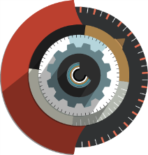
API Security Management – Decouple from Service
API Security Gateway
API Security Gateway
  The Service
  Mobile, B2B, Portal, Data …
  (HTML, XML, SOAP, REST, JSON, …)
  The Service
  Mobile, B2B, Portal, Data …
  (HTML, XML, SOAP, REST, JSON, …)

Slide 27


API Security Management – Decouple from Service
API Security Gateway
  Transport Security
  Role-Based Access Control
  Attribute-Based Access Control
Threat Mitigation
  The Service
  Mobile, B2B, Portal, Data …
  (HTML, XML, SOAP, REST, JSON, …)
    Integrity and Trust
    Data Privacy

Slide 28
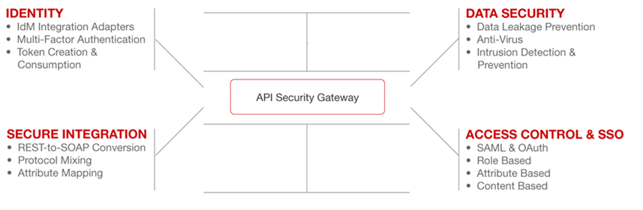

API Security Management
Declarative Policies with Identity + Data
API Security Gateway
Logical API
Actual API

Slide 29

API Architecture with Layered API Security
Public
Mobile
Cloud
Suppliers
Innovators
Unknown parties
Smart Devices
Employees
Partners
Monetary Services
Business APIs
Application APIs
Data APIs
Modern Enterprise

Slide 30
CONCLUSION
CONTACTS:
Raj S. Leyl, MBA, PMP – eVigilant Security
rleyl@evigilant.com
301-332-5166
http://www.evigilant.com
Randy Gardner – Forum Systems
rgardner@forumsys.com
703-915-0371
http://www.forumsys.com

