Slide 1
Group Based Licensing
Steve Scholz
US Education- Threat Management Technical Specialist
Contact:
http://aka.ms/M365staysecure

Slide 2
What is Group Based Licensing?
Microsoft paid cloud services, such as Office 365, Enterprise Mobility + Security, Dynamics 365, and other similar products, require licenses. These licenses are assigned to each user who needs access to these services. To manage licenses, administrators use one of the management portals (Office or Azure) and PowerShell cmdlets. Azure Active Directory (Azure AD) is the underlying infrastructure that supports identity management for all Microsoft cloud services. Azure AD stores information about license assignment states for users.

Slide 3
What does this mean for you?
Until now, licenses could only be assigned at the individual user level, which can make large-scale management difficult.
To address those challenges, Azure AD now includes group-based licensing. You can assign one or more product licenses to a group. Azure AD ensures that the licenses are assigned to all members of the group. Any new members who join the group are assigned the appropriate licenses. When they leave the group, those licenses are removed. This eliminates the need for automating license management via PowerShell to reflect changes in the organization and departmental structure on a per-user basis.

Slide 4
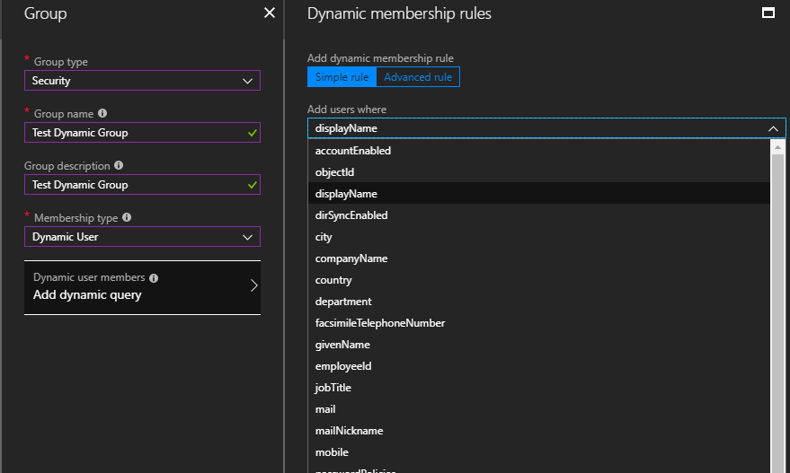
What groups can be used?
The feature can only be used with security groups. Office groups are currently not supported and you will not be able to use them in the license assignment process.
Cloud created or onprem synced groups.
Group-based licensing currently does not support groups that contain other groups (nested groups). If you apply a license to a nested group, only the immediate first-level user members of the group have the licenses applied.
With Azure Active Directory Premium you can use Dynamic Groups to help assign licenses.

Slide 5
How do I?
In Azure AD go to groups.
Choose the group you want to assign a license to or create one.
Choose license in the group blade.
Assign
Choose the products to license
If you need to adjust features of that product, assign options
Choose the license options.

Slide 6
Moving existing users to GBL.
Recommended migration process
You have existing automation (for example, PowerShell) managing license assignment and removal for users. Leave it running as is.
Create a new licensing group (or decide which existing groups to use) and make sure that all required users are added as members.
Assign the required licenses to those groups; your goal should be to reflect the same licensing state your existing automation (for example, PowerShell) is applying to those users.
Verify that licenses have been applied to all users in those groups. This application can be done by checking the processing state on each group and by checking Audit Logs.
You can spot check individual users by looking at their license details. You will see that they have the same licenses assigned “directly” and “inherited” from groups.
You can run a PowerShell script to verify how licenses are assigned to users.
When the same product license is assigned to the user both directly and through a group, only one license is consumed by the user. Hence no additional licenses are required to perform migration.
5. Verify that no license assignments failed by checking each group for users in error state. For more information, see Identifying and resolving license problems for a group.
6. Consider removing the original direct assignments; you may want to do it gradually, in “waves”, to monitor the outcome on a subset of users first.
You could leave the original direct assignments on users, but when the users leave their licensed groups they will still retain the original license, which is possibly not want you want.

Slide 7
Migrate users between products that have conflicting service plans
The migration goal is to use group-based licensing to change user licenses from a source license (Office 365 A1) to a (target license) Office 365 A3. The two products in this scenario contain conflicting service plans, so you have to work around the conflict to seamlessly migrate the users. For more information about these conflicts, see Active Directory licensing group problem resolution: Conflicting service plans. At no point during the migration should users lose access to services or data. The migration is performed in small "batches." You can validate the outcome for each batch and minimize the scope of any problems that might occur during the process.
Overall, the process is as follows:
Users are members of a source group and they inherit the source license from that group.
Create a target group with the target license but without any members.
Add a batch of users to the target group. Group-based licensing picks up the change and tries to assign the target license. The assignment fails due to conflicts between services in the two products. Group-based licensing records the failure as an error on each user. The process can take an extended amount of time, depending on the size of the batch and other activities in the tenant.
Verify that the batch of users is fully processed by group-based licensing. Confirm that each user has the conflict error recorded. Check that some users didn't end up in an unexpected error state. For more information about errors, see Active Directory licensing group problem resolution.
At this point, users still have the source license and a conflict error for the target license. The users don't yet have the target license assigned.
Remove the same user batch from the source group. Group-based licensing responds to the change and the source license is removed from each user. The conflict error is removed at the same time (when no other product license contributes to the error) and the target license is assigned. This process ensures that there's no loss of services or data during the transition.
Repeat the process for subsequent batches of users.
Sample PowerShell Scripts are available to automate and verify this process. https://docs.microsoft.com/en-us/azure/active-directory/users-groups-roles/licensing-groups-change-licenses#powershell-automation-of-migration-and-verification-steps

Slide 8
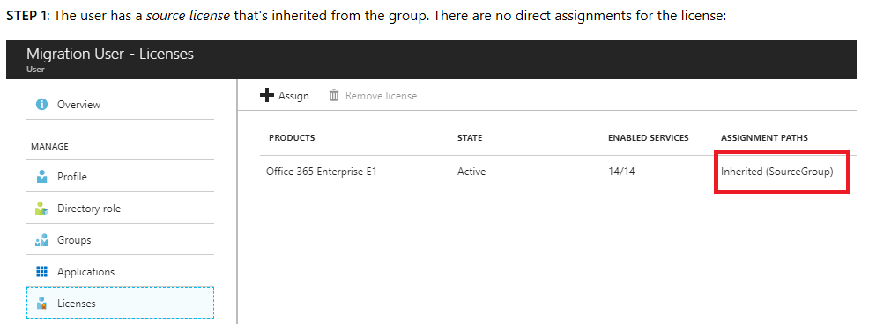
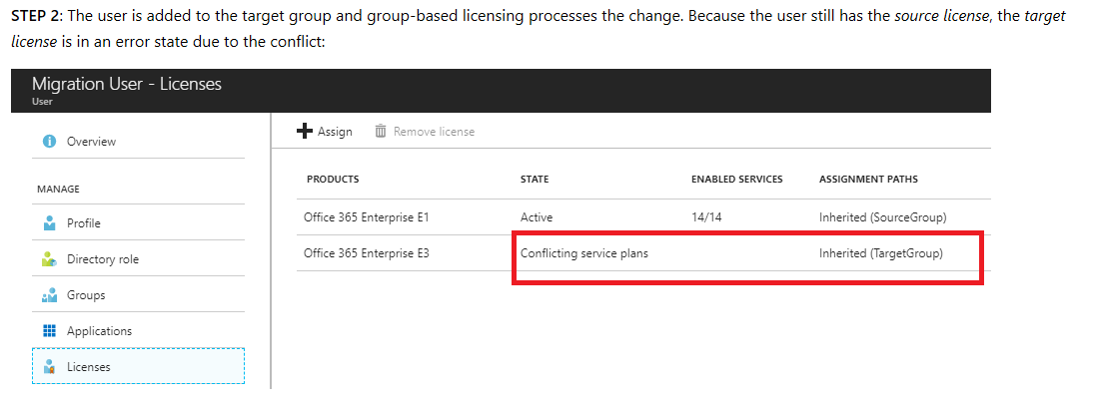
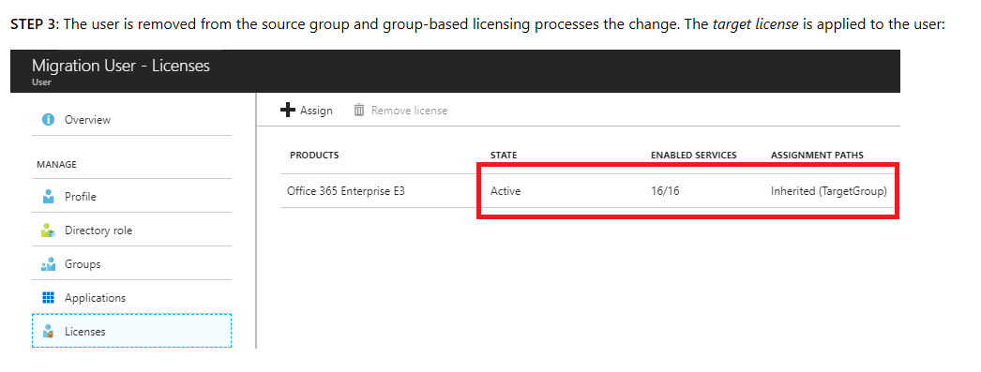

Slide 9
Work Around
Since many schools will have users with direct license assignment of Office 365 A1 or A1 ProPlus and need to assign Office 365 A3/5 licenses to minimize impact we suggest the following.
Identify or create a group to target for “temporary group licensing” and assign Office 365 A1/A1PP license to this group. Assign users to this group. Using Dynamic groups might be useful here.
Via PowerShell script remove the direct assigned license to the users.
Make sure direct assignment has been removed from users and it is inherited.
Identify or create a permeant group for users to have Office 365 A3/5 license assigned to and assign users to this group.
Check to make sure your users license assignments look similar to step two on the previous slide. The previous slide does have Enterprise licenses.
Remove users from the temporary group.
Check to see if users have the correct license assignment.

Slide 10
PowerShell What?
The idea of Group-Based Licensing is to simplify and really do away with the need for people to use PowerShell when doing licensing. Does this mean you can’t? No, you still have this ability. A few things.
1. When using PowerShell v1.0 cmdlets a String ID is used when using PowerShell v2.0 cmdlets or the graph a GUID is used.
AZURE ACTIVE DIRECTORY PREMIUM P1 | AAD_PREMIUM | 078d2b04-f1bd-4111-bbd4-b4b1b354cef4 | AAD_PREMIUM (41781fb2-bc02-4b7c-bd55-b576c07bb09d) MFA_PREMIUM (8a256a2b-b617-496d-b51b-e76466e88db0)
2. PowerShell Examples for Group Based Licensing
https://docs.microsoft.com/en-us/azure/active-directory/users-groups-roles/licensing-ps-examples
Product Identifiers –not many edu specific products in here I will work on getting those as a follow up. But they are in the UI ☺
https://docs.microsoft.com/en-us/azure/active-directory/users-groups-roles/licensing-service-plan-reference

Slide 11
Questions

