Slide 1
Bell Techlogix MEEC Microsoft Program 2015 – 2018
Microsoft Sales Office - Elkridge MD June 3, 2015

Slide 2
Welcome and Agenda
Differences between Option A and B
Licensing Windows Servers and the advantages of the Server Platform Agreements
Paperwork requirements for the new agreement (requires Windows Live ID – e-signature)
Questions

Slide 3
Two MEEC Options – 8/01/15
Option A
Option B
Desktop, ECAL, MDOP
Office ProPlus
Office 365 E1
Intune
Desktop, ECAL, MDOP
Office ProPlus
Office 365 E3
Enterprise Mobility Suite
Includes Intune, AAD,RMS

Slide 4
Education Desktop
Education Desktop with Enterprise CAL SUITE
Covers Faculty and Staff
Windows 7/8 Enterprise upgrade
Windows 10 (6/29/15)
Microsoft Office Professional Plus 2013 and Office for Mac 2011 and upgrade rights to next version
Microsoft Enterprise CAL Suites
Home Use Program (HUP) or Work at Home (WAH) rights for Faculty and Staff and local installation of Office Suite on home computers
Rights to Run Windows and Office for Faculty and Staff in a VDI environment
*vda not included

Slide 5
Core and Enterprise CAL Suite Portfolio
ECAL Suite Full-Stack
Core CAL Suite
ECAL Suite Step-Up
CAL
Active Directory Rights Management Services CAL
Exchange Online Archiving
Enterprise CAL
Standard CAL
Exchange Data Loss Prevention
Exchange Online Protection
Standard CAL
Enterprise CAL
Standard CAL
Enterprise CAL
Client Management Suite

Slide 6
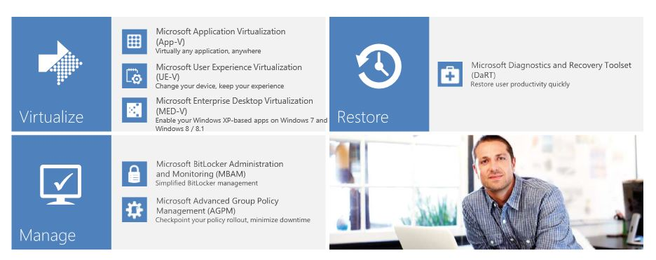
Microsoft Desktop Optimization Pack (MDOP)

Slide 7
Office 365 E1 & E3 | Office 365 Education E1 | Office 365 Education E3
Full, installed Office applications Word, Excel, PowerPoint, Outlook, Publisher, OneNote, Access, and Skype for Business on up to 5 PCs or Macs | X | X
Office on tablets and phones for the full, installed Office experience on up to 5 tablets and 5 p hones | X | X
Online versions of Office including Word, Excel, PowerPoint, and more | X | X
File storage and sharing with 1 TB storage/user | X | X
Business-class email, calendar, and contacts with a 50 GB inbox | X | X
Unlimited online meetings, IM, and HD video conferencing. Includes the Skype for Business app | X | X
I Intranet site for your teams with customizable security settings | X | X
Corporate social network to help employees collaborate across departments and locations | X | X
Personalized search and discovery across Office 365 using the Office Graph | X | X
Corporate video portal for uploading and sharing your corporate videos across the company | X | X
Office 365 Compliance Center includes Data Loss Prevention |  | X
In-Place Hold, Email Archive, eDiscovery Center Tools to support compliance |  | X
Office Message Encryption, Azure Rights Management Services |  | X
Voicemail Hosted voicemail support with auto attendant capabilities |  | X

Slide 8
The Office 365 ProPlus Benefit
Purchase volume licenses for
Get ProPlus free for
100%
100%
Of students, faculty & staff
of faculty and staff

Slide 9
Office 365 Pro Plus | What is it?
Latest productivity suite delivered and maintained by Microsoft’s cloud
Office Suite | Versioning | License | Activation | Servicing
Office 2013 Pro Plus (Volume License MSI) | 2013 | Per-desktop | KMS Server or MAK Key | Layered (additive)
Office 365 Pro Plus (Click-to-Run) | Always Current (Evergreen) | Per-User (5 desktops + mobile/tablet) | Office 365 – Every 30 days | Slipstreamed (differential)
Windows 7 or newer
Windows Integration
App-to-App Integration
Object Model/Add-in Extensibility
Group Policy Support
Automated Deployment
Selective Application Installation
Telemetry
Supports Offline Use
On premises or cloud storage
“The last Office suite you will ever need to deploy!”

Slide 10
Office 365 (3) Education Plans
Voice |  |  | Uplift offer Plan E4
Access, Excel, Forms, Visio Services |  | Option 2 E3
Voicemail & Compliance Archiving
Office 365 ProPlus | Student and Teacher Advantage *No Additional Cost
Office Web Apps | Option 1 E1
IM & Presence (lync - skype for business)
Collaboration Portal (Sharepoint/Yammer)
Conference (lync - skype for business)
Email, calendar, AV/VS, Personal Archive, unlimited personal storage, Exchange online/ OneDrive for Business

Slide 11
INTUNE
Microsoft Intune

Slide 12
Windows Intune
Windows PCs
(x86/64, Intel SoC)
Windows RT, Windows Phone 8 iOS, Android
IT
Web-based Admin
Console

Slide 13
Enterprise Mobility Suite

Slide 14
Introducing the Enterprise Mobility Suite
Hybrid identity
Microsoft Azure Active Directory Premium
Group management, security reports, and audit reports
Self-service password reset and multi-factor authentication
Connection between Active Directory and Azure Active Directory
Mobile device management
Microsoft Intune
Mobile device settings management
Mobile application management
Selective wipe
Access & Information protection
Microsoft Azure Rights Management service
Information protection
Connection to on-premises assets
Bring your own key

Slide 15
Server Platform Licensing Options
Server Products Included for
Unlimited Deployment
CAL Product
Server Platform
Core CAL Suite
Core Server Platform
Windows Server, including Hyper-V (all editions)
Microsoft SharePoint Server (all editions)
Microsoft Exchange Server (all editions)
Microsoft Lync Server (all editions)
Windows Server External Connector
Enterprise CAL Suite
Enterprise Server Platform
Includes everything listed in Core Server Platform, plus
Microsoft System Center Datacenter
Windows RMS External Connector
SQL Server CAL
SQL Server Platform
SQL Server Enterprise
SQL Server Standard
SQL Server Business Intelligence
Microsoft BizTalk Server (all editions)
.

Slide 16
Forefront
ProtectionSuite
Deeper Review of CAL Suite Capabilities
Document & E-mail Security Management
File & Print
Active Dir.
IIS & SPF
Unified Messaging
Compliance
Messaging
Calendar
Contacts
E-Forms
Business Intelligence/KPI
Data Integration
ECM
Portal
Search
Unified Communications
Multi-Party Conferencing
PBX Integration
IM
Presence
Telephony
System Center Client Suite
Help Desk Management
Backup & Recovery
Process Automation
Deployment
Mgmt
Asset Inv.
Advanced Virtual Mgt.
Proactive Monitoring
Assessments and Solutions
Desktop Virtualization
Mobile Device Management
AntiVirus
AntiSpam
Security
Notes:
16

Slide 17
Paperwork requirements for agreement
(requires Windows Live ID – e-signature) <Signup.live.com>
True Up Form: Due back to Bell Techlogix, Email or Fax by June 12, 2015
EES Enrollment
Program Signature Form
Select Plus Enrollment
Program Signature Form
Purchase Orders: Due back to Bell Techlogix, Email or Fax by July 17, 2015

Slide 18
True-Up Form
The true up form includes the following:
Institution Name
Contact Name
Email
Phone
Institution Counts
Selection of Options
Questions concerning the True-Up Form should be directed to your contact at BellTechlogix.

Slide 19
Other events and resources
Events
MEEC Webinars
Workshops – SSP led
Professional Development
Teacher Academies
Windows in the Classroom
MIC/MEC more 3 letter tools
BING IN THE CLASSROOM
Microsoft Programs Dreamspark Standard
IT Academy
Premier Support
Hardware
Surface Devices

Slide 20
Microsoft Account Team
Bell Techlogix Account Team
Jamie Bakert
Strategic Account Executive
jamie.bakert@microsoft.com
Missy Wisniewski
Maryland Account Director
mwisniewski@belltechlogix.com
Bryan Zatkulak
Director, Inside Sales
bzatkulak@belltechlogix.com
Janet Immink
Strategic Account Executive
jimmink@microsoft.com
Lisa Goolsby
Inside Sales
lgoolsby@belltechlogix.com
Sarah Taggart
Business Development Manager
staggart@belltechlogix.com
Tayo Jackson
Account Technology Strategist
tayoja@microsoft.com
Dana McNeil
Inside Sales
dmcneil@belltechlogix.com
Chad Kearsley
ATU Director
Chad.Kearsley@microsoft.com

