Slide 1
MEEC Vendor Orientation Maryland Education Enterprise Consortium

Slide 2
MEEC
Hosted by the University System of MD
Governed by a Board of Directors
MEEC Staff
Executive Director – Tamara Petronka
Assistant Director – Darby Ashmore
Part time staff member – Pat Collins

Slide 3
Membership
Membership open to MD K-20 Public, Private and Federal Educational Institutions and Libraries
213,000+ FTE of Faculty and Staff
~201 Educational entities
~1.25 Million Students

Slide 4
MEEC’s Goals
Provide members opportunities to acquire quality hardware, software & services at competitive prices
Promote interaction with vendors
Meet the needs of the members through additional services

Slide 5
MEEC Agreements
As of 6.30.16
15 Agreements
74 Vendors
14 Vendors hold multiple contracts

Slide 6
MEEC Agreements
As of 7.1.16
16 Agreements
93 Vendors
15 Vendors hold multiple contracts

Slide 7
Contract Solicitations
Contract Solicitations - USM institutions or Community Colleges
MD State/USM procurement guidelines
Agreements vetted through the Office of the MD Attorney General
Goal of no differential pricing
Secondary competition
Further negotiate

Slide 8
Contract Manager
Steve Jost
Director of Procurement, Bowie State University
sjost@bowiestate.edu

Slide 9
Purchasing
Only MEEC members may purchase from MEEC agreements

Slide 10
Workshops/Seminars
Opportunity to offer web/in-person seminars
ROI
Member Conference and Vendor Showcase

Slide 11
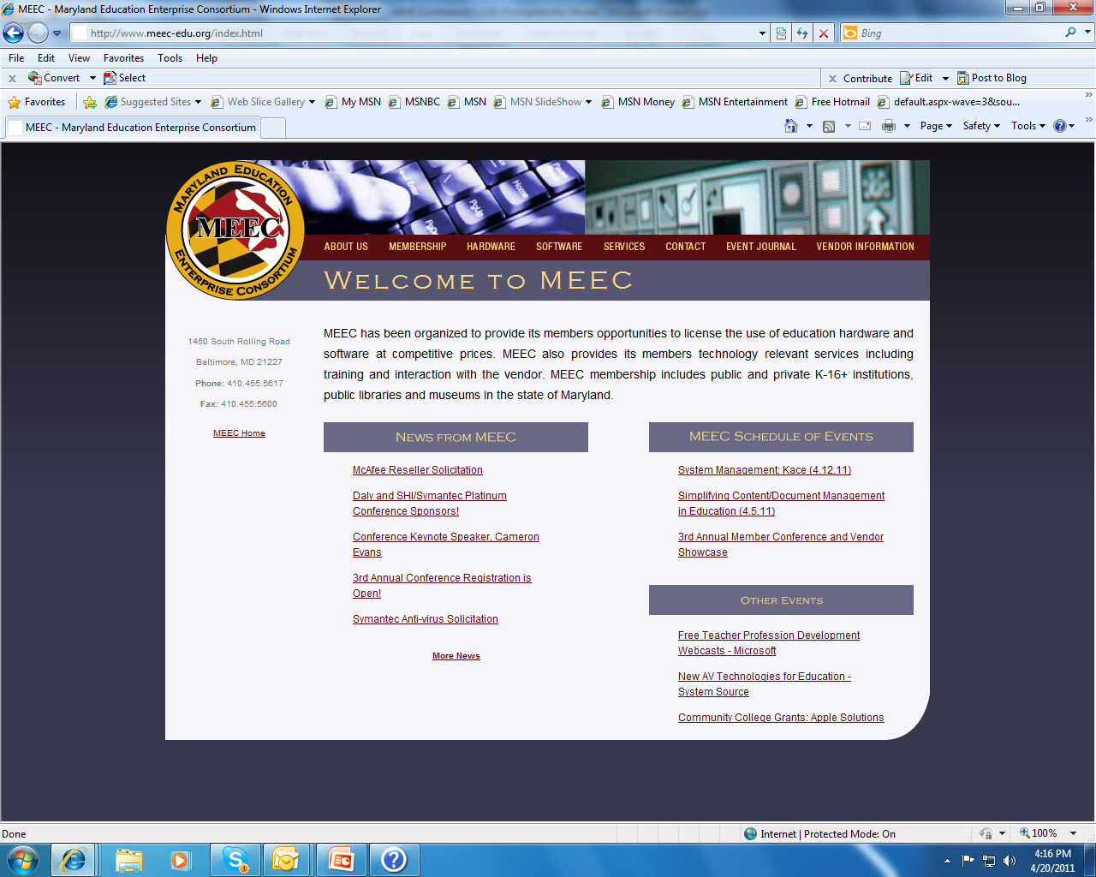

Slide 12
How can MEEC help you?
How can you help MEEC?
Are you a member or do you just belong?

Slide 13
Contact Information
http://www.MEEC-edu.org
Tamara Petronka
tpetronka@usmd.edu 410-455-5617
Darby Ashmore
dashmore@usmd.edu 443-543-5680
Pat Collins
pcollins@usmd.edu 410-455-5661

